Slide 1


AML PROJECT: CLOSING PRICE
PREDICTION
Dhruvi Shah, Siqing Guan, Youjia Li, Yue Wu, Linxuan Zheng

Slide 2
Dataset descriptions
We sourced data for the stocks of Apple, Google, and Amazon from Yahoo Finance, for every trading day from October 9, 2018, to October 9, 2023. The datasets encompass different variables, including Open, Close, High, Low, Volume, and Adjusted Close prices. We also include market index like S&P 500, providing a broad benchmark for the overall performance of the stock market. Our purpose is to employ the mentioned variables to predict the Adjusted Close Price for each of these three companies in the following trading days.
Adjusted Closing Price :The adjusted closing price is the closing price after dividend payouts, stock splits, or the issue of additional shares have been taken into account.

Slide 3
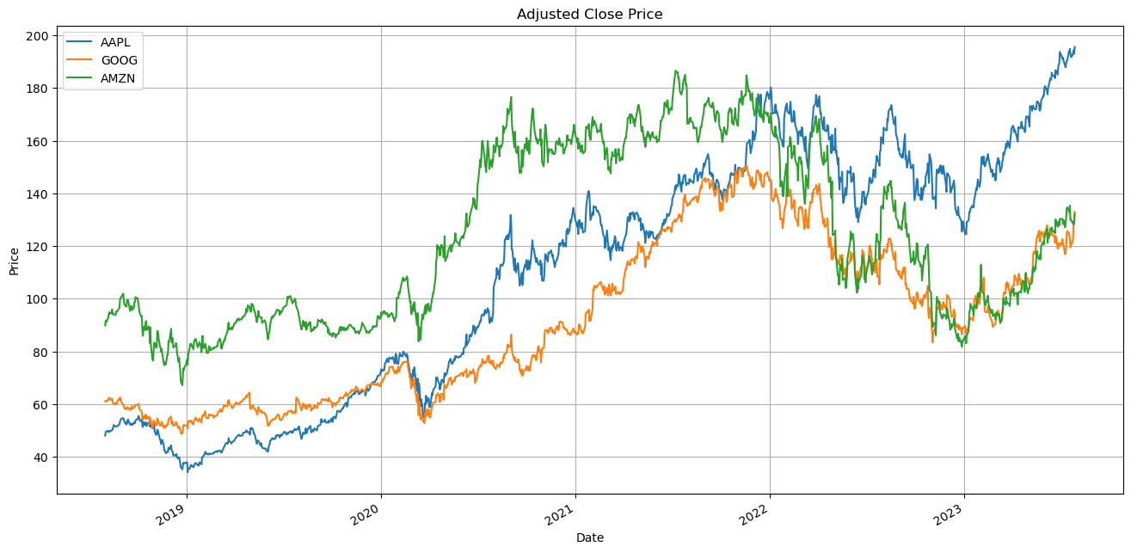
Closing price over time
Note : Overall, closing price of these stocks has been increasing over time and doesn't seem to be statiotionary. We need to apply transformations for forecasting.
Notes:
Overall, closing price of these stocks has been increasing over time and doesn't seem to be statiotionary. We need to apply transformations for forecasting.

Slide 4
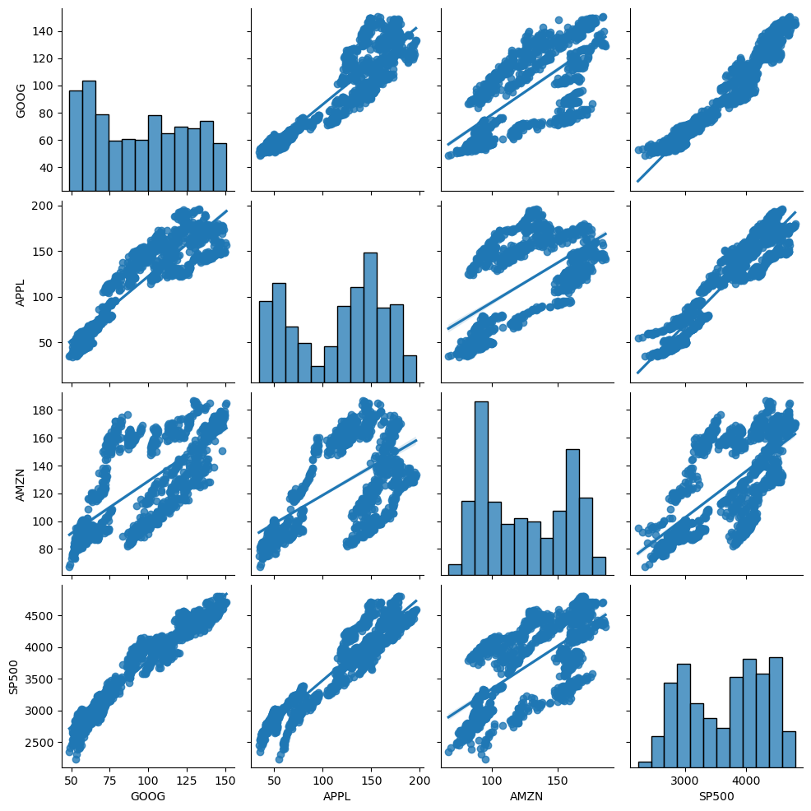
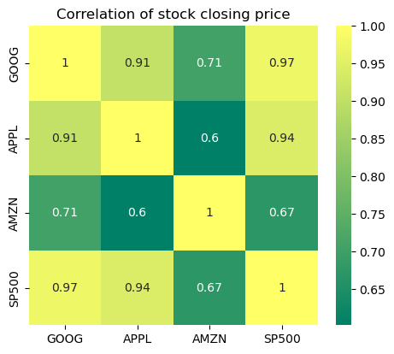
Correlation between three stocks and market index
By the graph, all chosen stocks are positively correlated with each other and the market index. However, there are certain pairs have noticeably high correlations that may cause the problem of multicollinearity for further prediction(GOOG&SP500, AMZN&APPL,GOOG&APPL), we will consider appropriate approaches to handle that in the next stage.

Slide 5
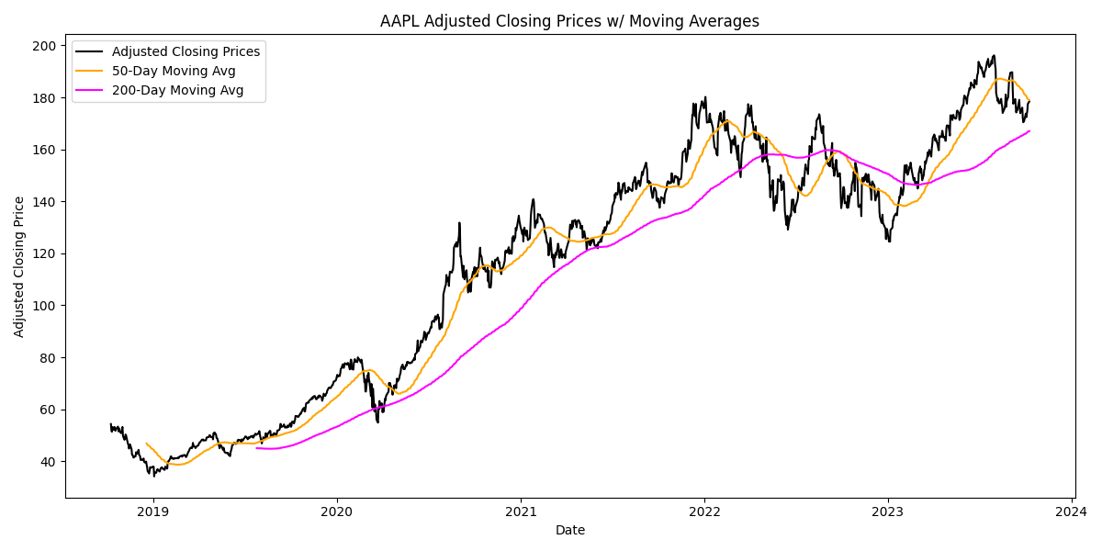
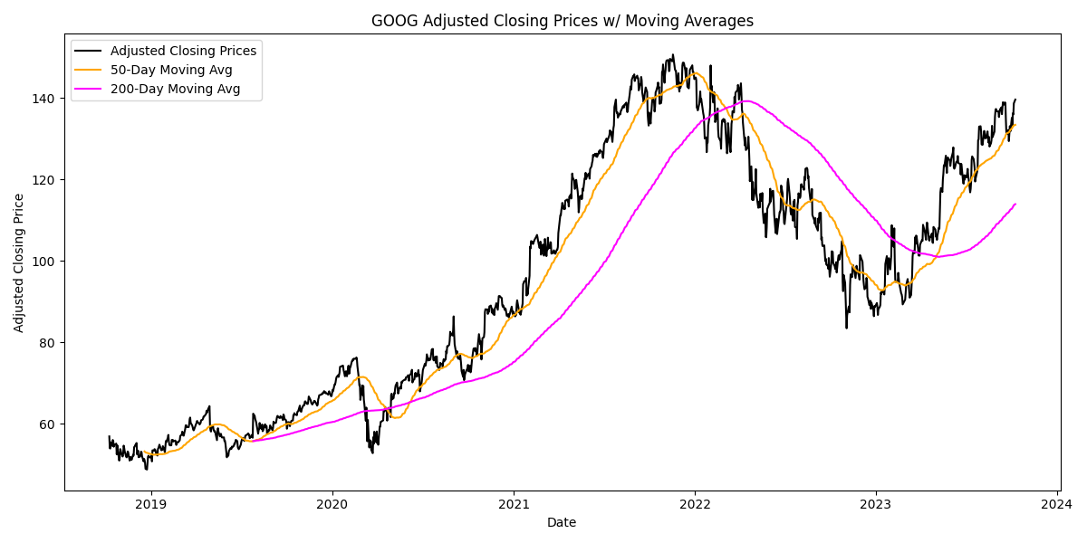
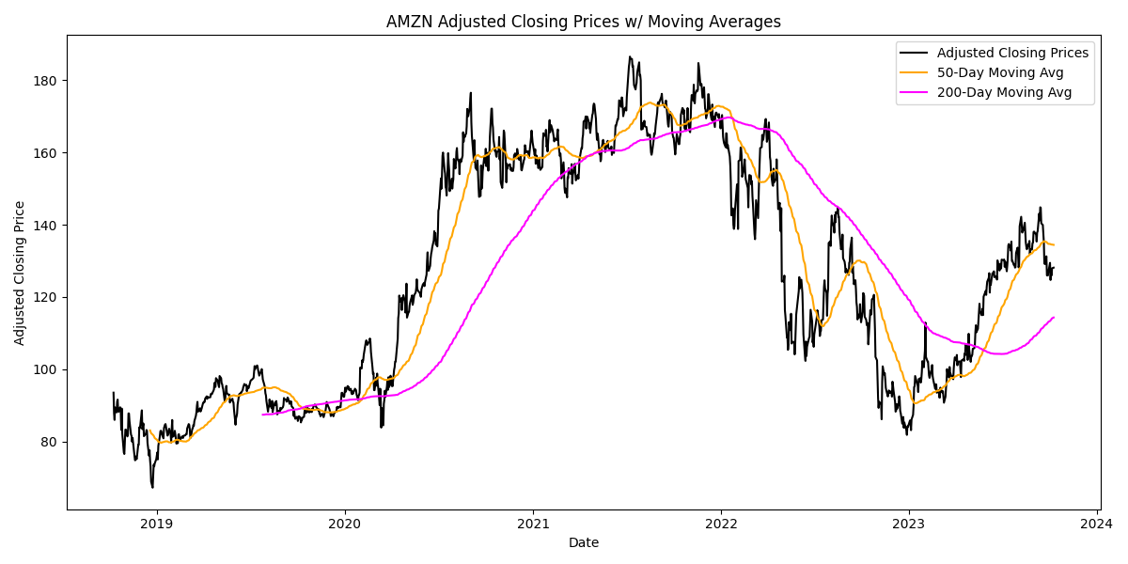
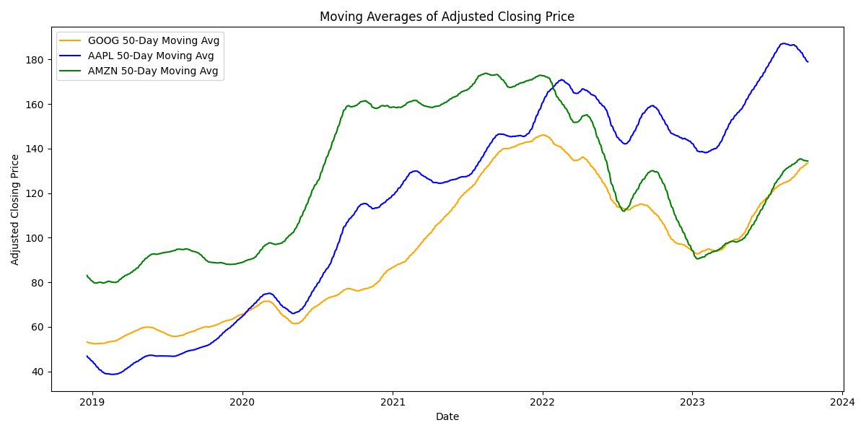
Adjusted Closing price with moving avg
Note: Moving averages help us smooth out the data from fluctuations and see the overall trends more clearly. As we can see here in the plots, adjusted closing price of AAPL has the most stable increasing trend, while adjusted closing price of GOOG and AMZN both exhibit an upward trend first and a downward trend, before returning to an upward trend. Apple stock has the best performance over the last five years, followed by google, and lastly amazon.
Notes:
Moving averages help us smooth out the data from fluctuations and see the overall trends more clearly. As we can see here in the plots, adjusted closing price of AAPL has the most stable increasing trend, while adjusted closing price of GOOG and AMZN both exhibit an upward trend first and a downward trend, before returning to an upward trend. Apple stock has the best performance over the last five years, followed by google, and lastly amazon.

Slide 6
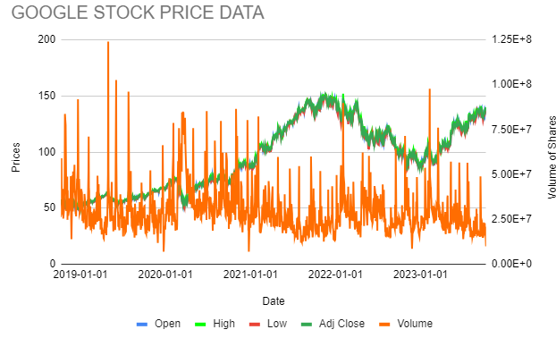
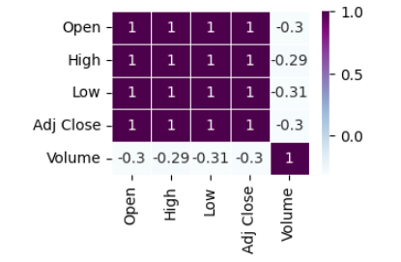
Correlation with Open, High, Low, Volume with Adj Closing
Note: Analyzing the patterns and correlations between 'Open,' 'High,' and 'Volume' with the 'Adjusted Close Price' is essential. In this dataset, Google, Amazon, and Apple exhibit similar patterns. Notably, 'Volume' shows no correlation with the 'Adjusted Close Price,' suggesting it may not significantly impact Stock Price Direction Prediction. Other factors and variables should be considered for more accurate predictions but highly correlated need to apply some transformations
Notes:
Analyzing the patterns and correlations between 'Open,' 'High,' and 'Volume' with the 'Adjusted Close Price' is essential. In this dataset, Google, Amazon, and Apple exhibit similar patterns. Notably, 'Volume' shows no correlation with the 'Adjusted Close Price,' suggesting it may not significantly impact Stock Price Direction Prediction. Other factors and variables should be considered for more accurate predictions but highly correlated need to apply some transformations

Slide 7
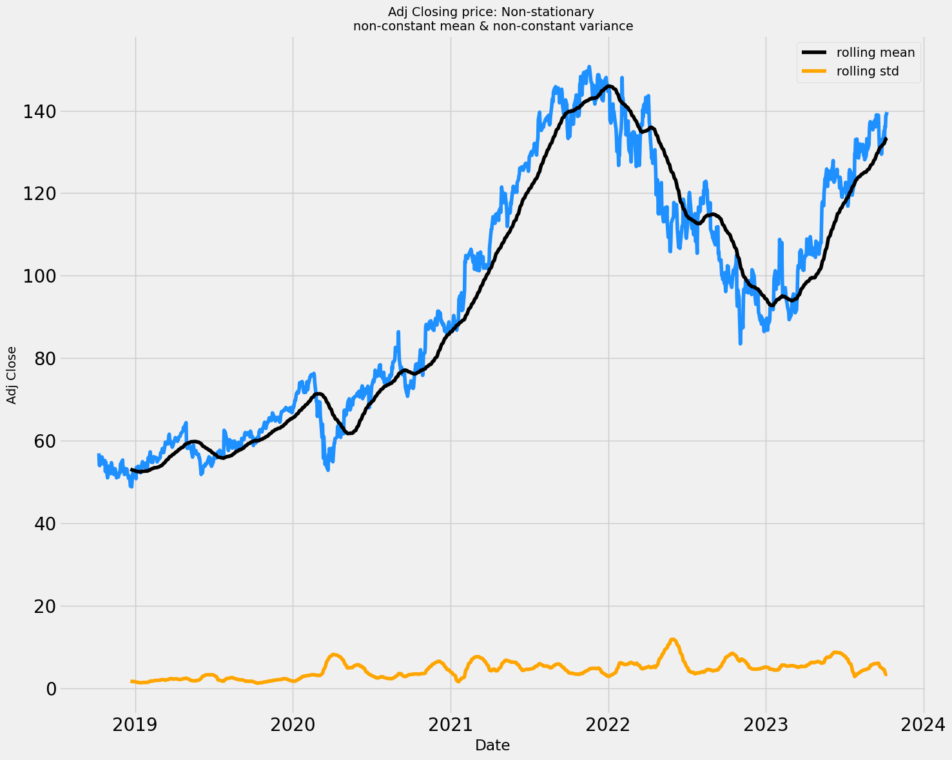
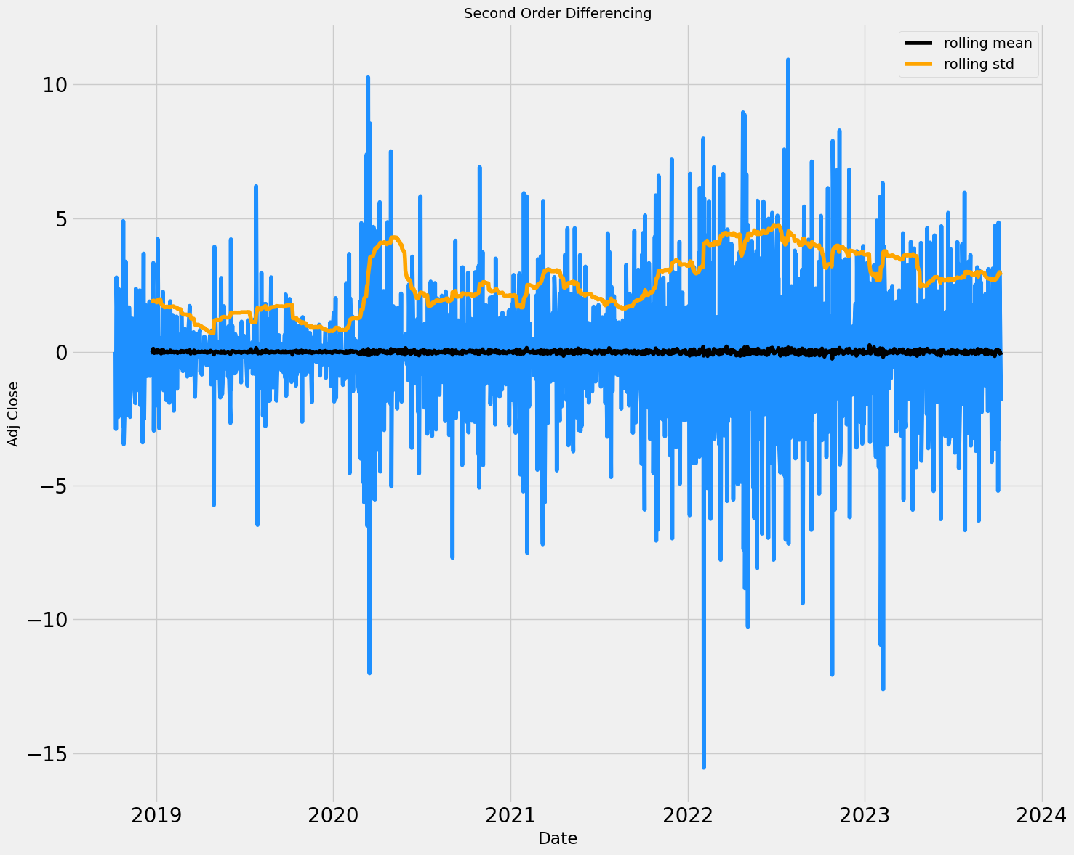
Stationary Check and Transformation
If a time series has a trend or seasonality component, it must be made stationary before we can use certain Time Series Model(e.g. ARIMA)to forecast. It appears so in our case, so we stationarized our data through second order differencing, which then passed the ADF stationarity test. (p-value is <0.05)

Slide 8
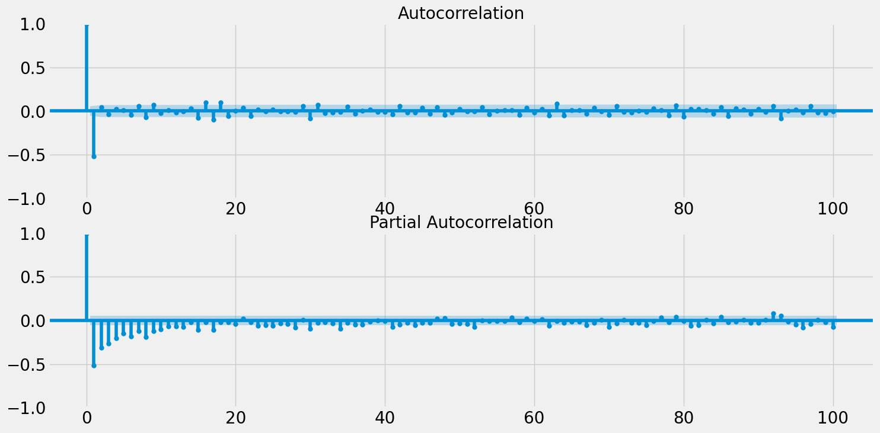
AutoCorrelation Analysis
Autocorrelation analysis examines how past values in a time series influence future values, aiding in the determination of the autoregressive (AR) and moving average (MA) components' orders (p and q) for ARIMA models.

Slide 9
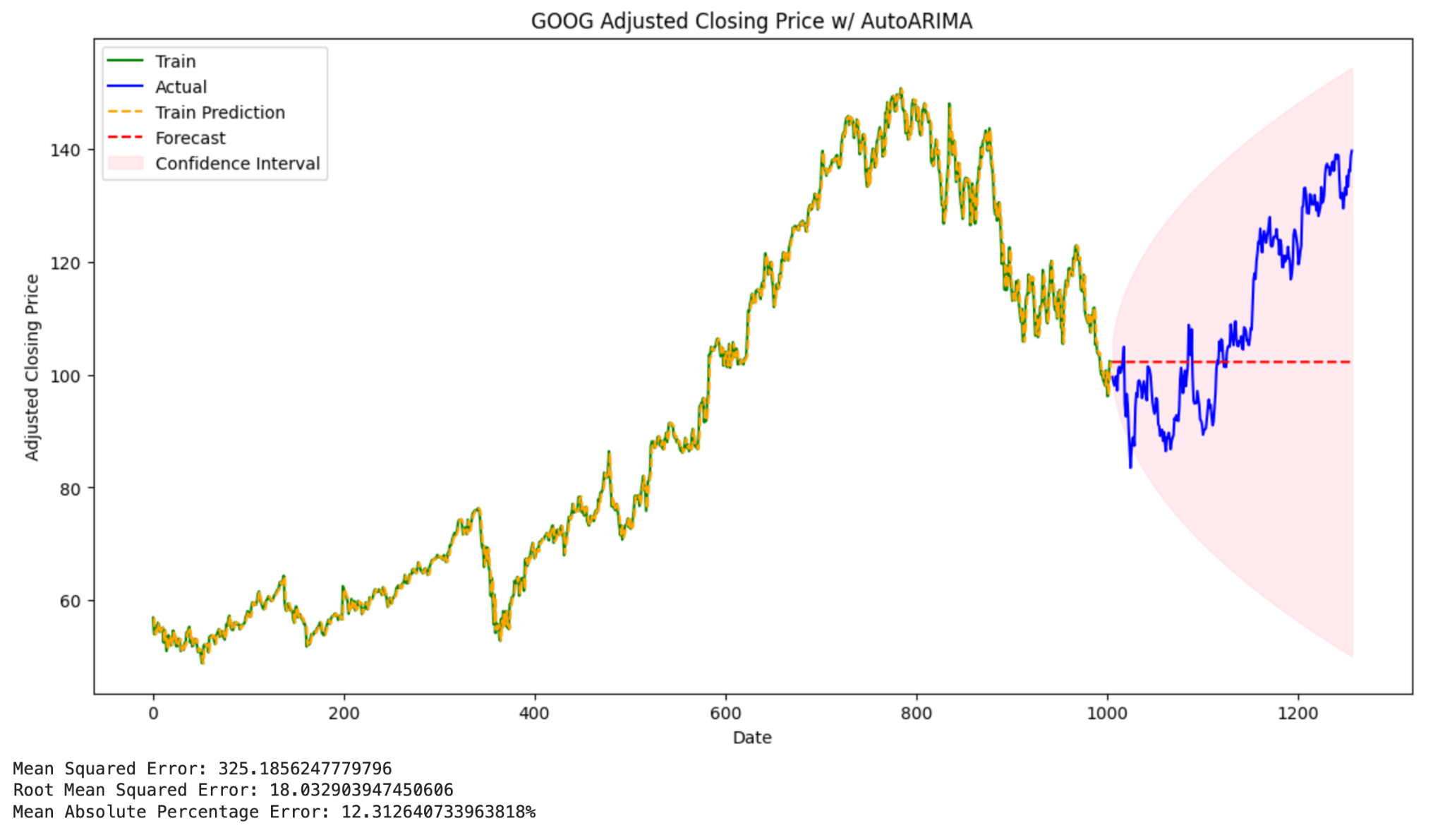
Time Series Techniques
ARIMA & ARIMAX IMPLEMENTATION:
Our analysis will primarily focus on predicting future 'Adjusted Closing Prices' using lagged observations, as visualized in the provided graphs. We will start by evaluating the model's performance based on historical 'Adjusted Closing Prices' as our baseline. Subsequently, we will enhance the model by introducing multiple external factors, considering an ARIMAX (AutoRegressive Integrated Moving Average with Exogenous Variables) approach. This more comprehensive analysis aims to improve the accuracy and robustness of stock price predictions.
As an example, we present here the prediction of Google’s adjusted closing price. Our Baseline Model applies autoARIMA from pmdarima library, which uses (p,d,q) of (1,1,0). It gives us a result with MSE of 325.19, RMSE of 18.04, and MAPE of 12.31 on the test set.

Slide 10
ML Techniques
Recurrent Neural Network (RNN) : Well suited time-series technique, we will use open, high, low, close prices, and maybe exogenous variable such as economic indicators, market sentiment, or news sentiment scores to predict the closing price.
LSTM: use open, high, low, close prices ,and technical indicators effectively modeling and predicting sequences of data
Classification: It involves training a machine learning model using historical stock price data, technical indicators, and potentially sentiment data. The model categorizes future price movements (e.g., up, down, or unchanged) based on historical patterns and relevant features. By applying classification algorithms like logistic regression or random forests, this approach aids traders and investors in making informed decisions regarding stock positions and trading strategies.

